Slide 1
Activities of Daily Living (ADL) Datasets
Muhammad Ali Murtaza

Slide 2
What is Activity for a Human
Human Activities are the various actions done by humans in their life.
Activities could be farther divided hierarchy wise:
Low level Activities
Example Standing, Walking, Sitting
High Level Activities
Example Cooking, Eating, Dancing
Activities could be farther divided interaction wise:
Human to Object Interaction
Example Opening door, Horse Riding
Human to Human interaction
Example Talking to Human, Handshaking

Slide 3

Activities of Daily Living
The task of every day life.
In Health Care domain ADL described as fundamental actions required for a human to live independently.
Example Eating, Bathing, Mobility

Slide 4
ADL Datasets
Following are some ADL video datasets that are publicly available.
HMDB51
Charades
ActivityNet
Kinetics
20BN-SOMETHING-SOMETHING
FCVID

Slide 5
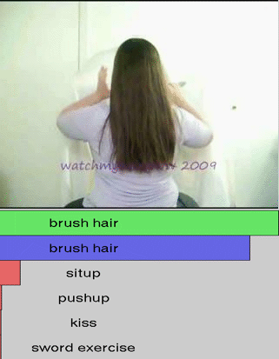
HMDB51
Data collection from Movies and web videos.
Contain 6766 video clips from 51 action categories or classes.
Each class have at least 101 samples.
Some example classes are mentioned:
Chew
Drink
Eat
Fall flower
Laugh
Pour
Golf
Pick
Jump
Hug
Kick Ball
Brush Hair
Drive
Laugh
Pullup
Punch
Catch
Clap

Slide 6
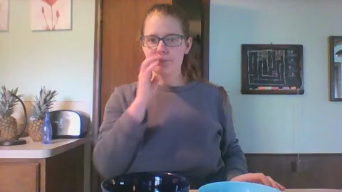
Charades
Dataset composed of 9848 video indoor activities of 30 second length.
Contain 157 action classes.
Each video annotated with multiple free text.
267 users with interacting 46 objects are presented in this dataset.
Dataset with different version (480p, Original Videos, Optical Flow) are publicly available on the internet.
Pour

Slide 7
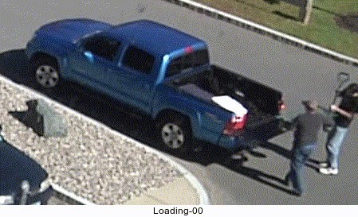
ActivityNet
Dataset contains 200 activities of daily living.
Contains 849 hours of video recording from YouTube.
Version 1.3 of ActivityNet contains 19994 untrimmed videos.
Each activity contains 137 untrimmed videos on average.
Division ratio for training, testing and validation is 2:1:1 respectively.

Slide 8
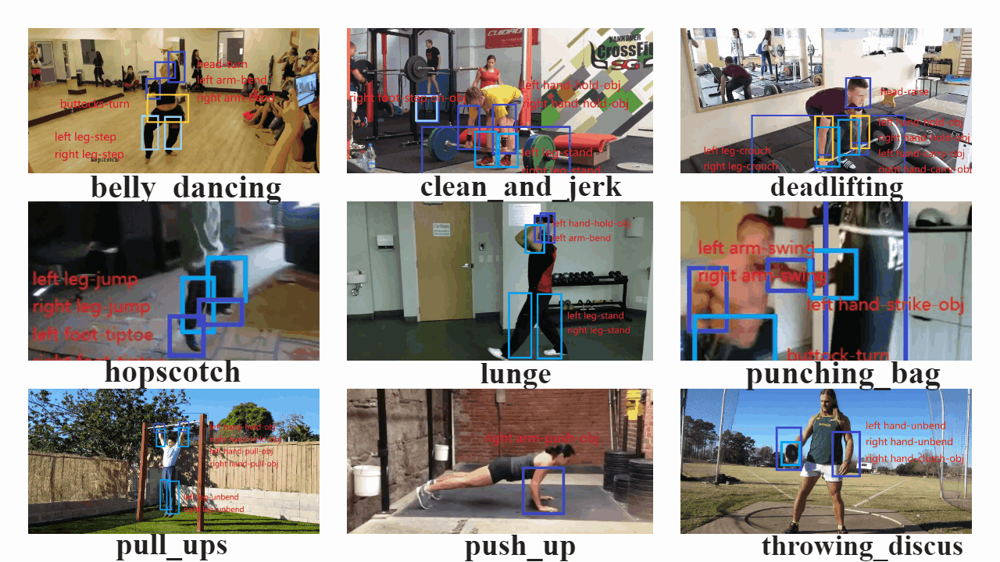
Kinetics
Kinetics contains 650,000 video clips covering 400/600/700 human action classes depending on versions.
Videos include human-object interaction like playing instruments and human-human interaction like shaking hands, etc.
Each video is annotated with single action class and least of 10 sec length.

Slide 9
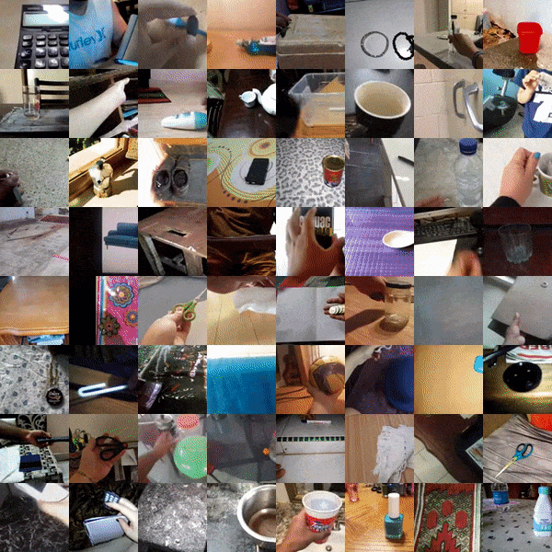
20BN-SOMETHING-SOMETHING
Dataset contains 220,847 videos of human pre-defined basic actions with everyday objects.
It allows model to fine-grained understanding of objects in physical world.
Dataset have 174 have total classes.

Slide 10

FCVID (Fudan-Columbia Video Dataset)
Dataset contains 91,223 web videos which manually annotated to 239 categories.
FCVID covers fine grained activities like making cake or objects like panda and scenery like beach.
Scenery

Slide 11

Questions

